Slide 1

Computing for BA Project “IMDB VIDEO GAMING RATING” FALL 2022 Group 10
Group members:
Somasekar Sai Gutti,
Thushar Mohan,
Syed Ali Asghar.

Slide 2
Introduction
The report is based on analyzing “the IMDB rating of video games” from Kaggle website
we have found this dataset.
Python programming language has been used to find out the data summary and dependency of each variable with each other.
The dataset has been analyzed using data preprocess or data cleaning, data normalization, exploratory analysis and so on.
Google Colab has been used as a development environment to run the Python code fragments by importing several Python libraries.
DCOVA framework is being followed in this python worker where each requirement has been followed for statistical analysis.

Slide 3
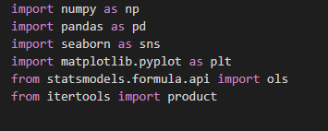
Design and implementation
Defining the data
Importing libraries and data set
In the above code, head() has been used in the dataset which has been stored into the df variable.
The above illustration represents the dataset with variables and observations.

Slide 4

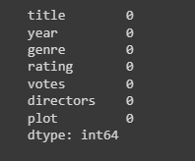

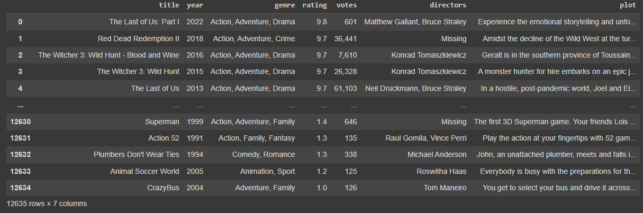
Collect the data
Data pre-processing or data cleaning:
Finding missing values:
Output of code

Slide 5


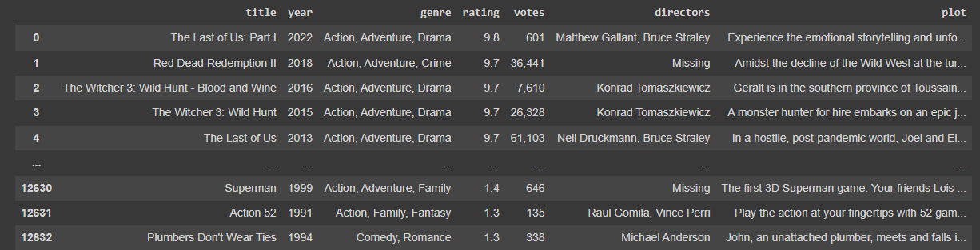
2. Removing duplicates
Duplicate values in variables
Dropping Duplicates

Slide 6
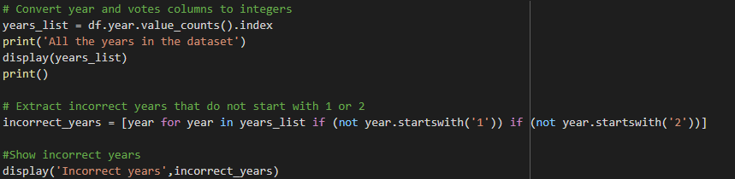
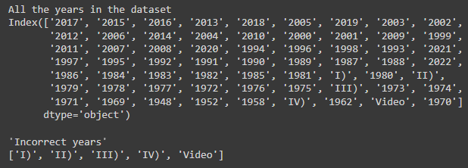
3. Converting float or string columns to integer
The above code is used to convert the string or float values to integers for programming purposes.

Slide 7
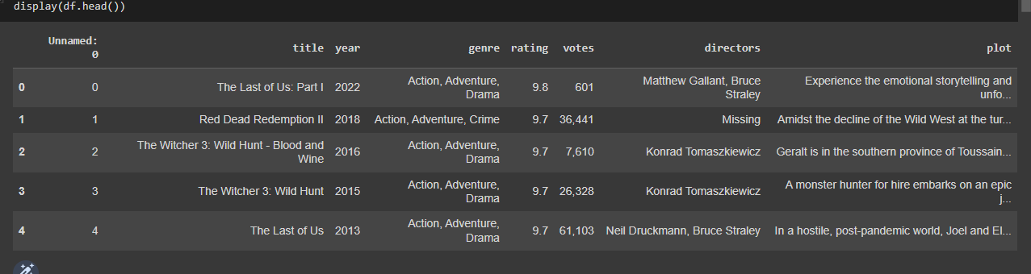
4. Developed dataframe with minimum data
The dataset has been built by removing all the missing values, duplicate values. This is called a “data frame” which will be used in further programming.

Slide 8
Organize the data

Slide 9

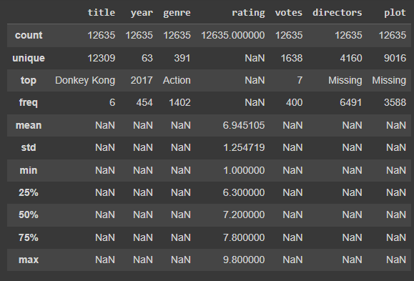
Categorical
Summary table or Descriptive analysis:
Descriptive analysis has been conducted using the describe() function on the dataset.
The describe() will show the min, max, mean value, standard variable in order to describe the properties of the variables in the dataset.

Slide 10
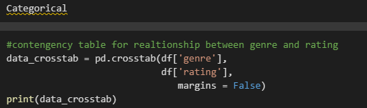
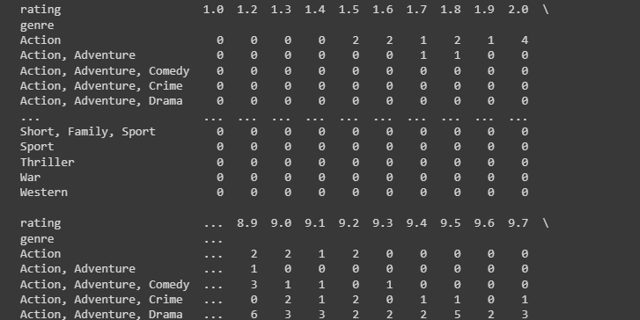
Contingency table to showcase the relationship between variables
Relationship between genre and rating

Slide 11

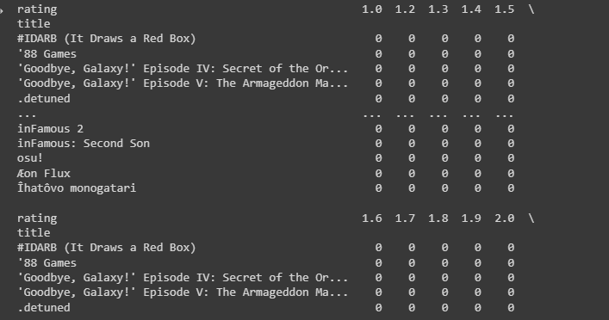
2. Relationship between genre and votes

Slide 12
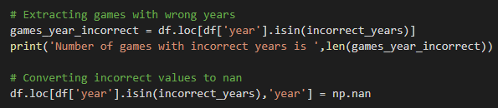
3. The detection of incorrect year

Slide 13

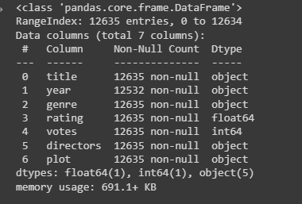
4. Converting column to integer

Slide 14
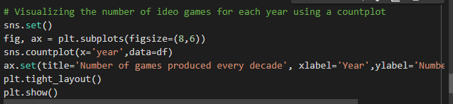
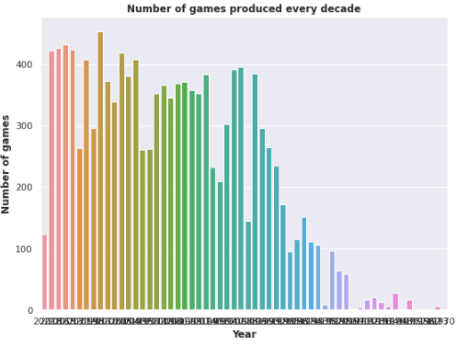
5. Number of games produced each year
The above graph shows the frequency of games production each year.

Slide 15
Numerical

Slide 16
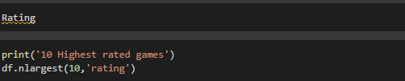
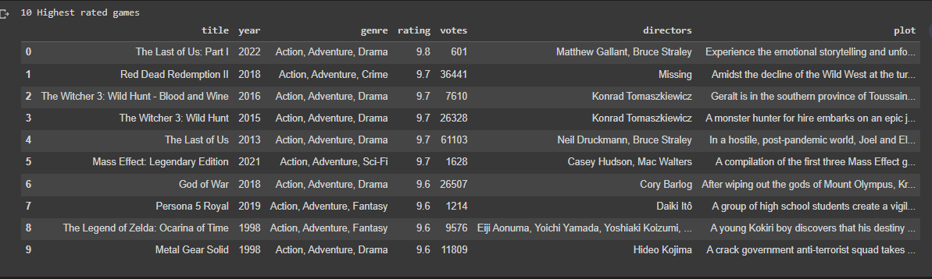
Games with the highest rating on

Slide 17
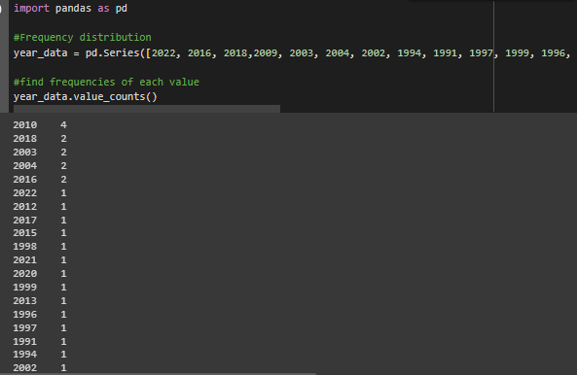
2. Frequency distribution
High frequency data can be accurately collected at an efficient rate of analysis.
Highest data refers to time series data collection, at extremely fine scale.

Slide 18
Visualizing the data

Slide 19
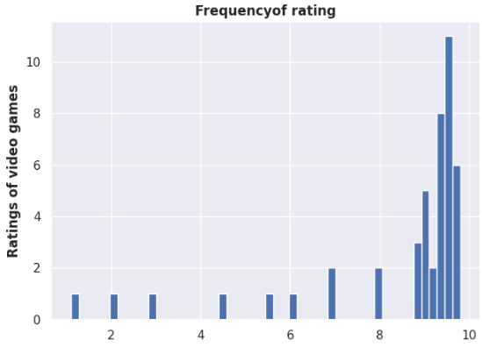
Histogram production

Slide 20
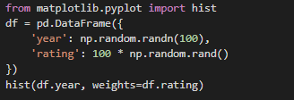
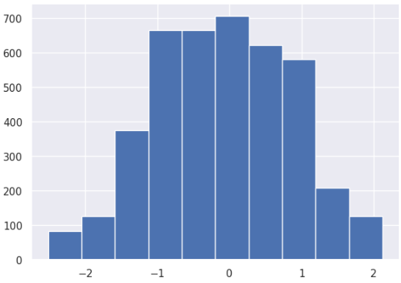
2. Histogram of the frequency of year and rating:

Slide 21

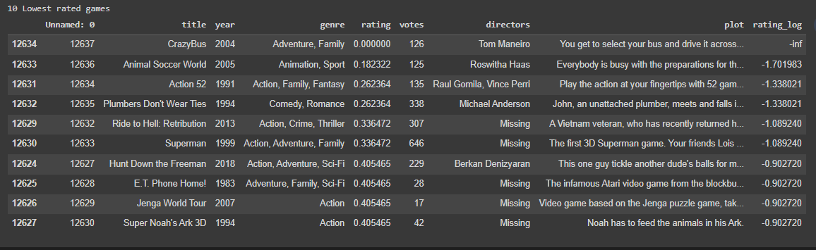
3. Lowest rated games display

Slide 22
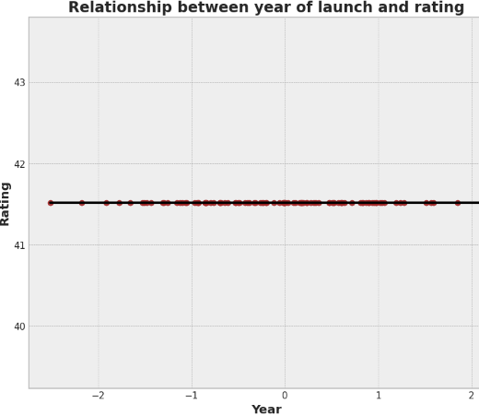
4. Relationship between year and rating

Slide 23
Analyzing the data

Slide 24
Summary statistics:

Slide 25
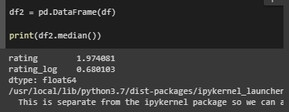
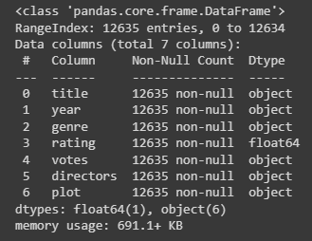
2. Median calculation:
3. Dataset info calculation

Slide 26
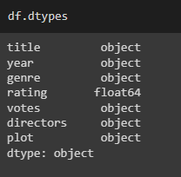


4. Datatypes of the variables
5. Calculating variance of rating variable
The value of variance of rating is 0.49133. The data type of rating is float

Slide 27

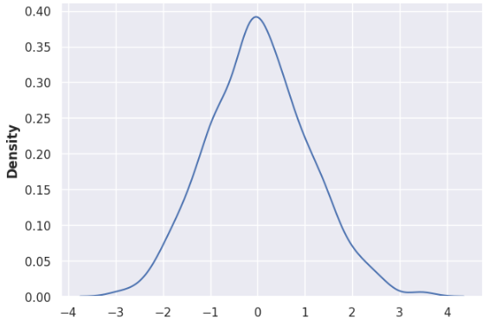
6. Normal distribution:

Slide 28
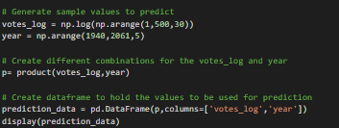
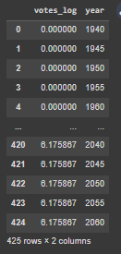

Slide 29
Conclusion
The report has been successfully conducted using Python programming language.
Each and every requirement has been achieved using proper tools and techniques.
The IMDB rating of video games has been analyzed in order to find relationships between variables of the dataset.
Each task is conducted in order to find how the games are rated or which attributes influence the rating and votes of the video games.
We have fulfilled all requirements for DCOVA (define, collect, organize, visualize, and analyze).

Slide 30
Q & A

